Slide 1
MEDIA IN ELECTIONS WORKSHOP
Electoral Commission of
South Africa
POLITICAL PARTY FUNDING
08 August 2023

Slide 2
CONTENTS
Political Party Funding Act
Challenges Encountered
Commission/Media Relationship

Slide 3
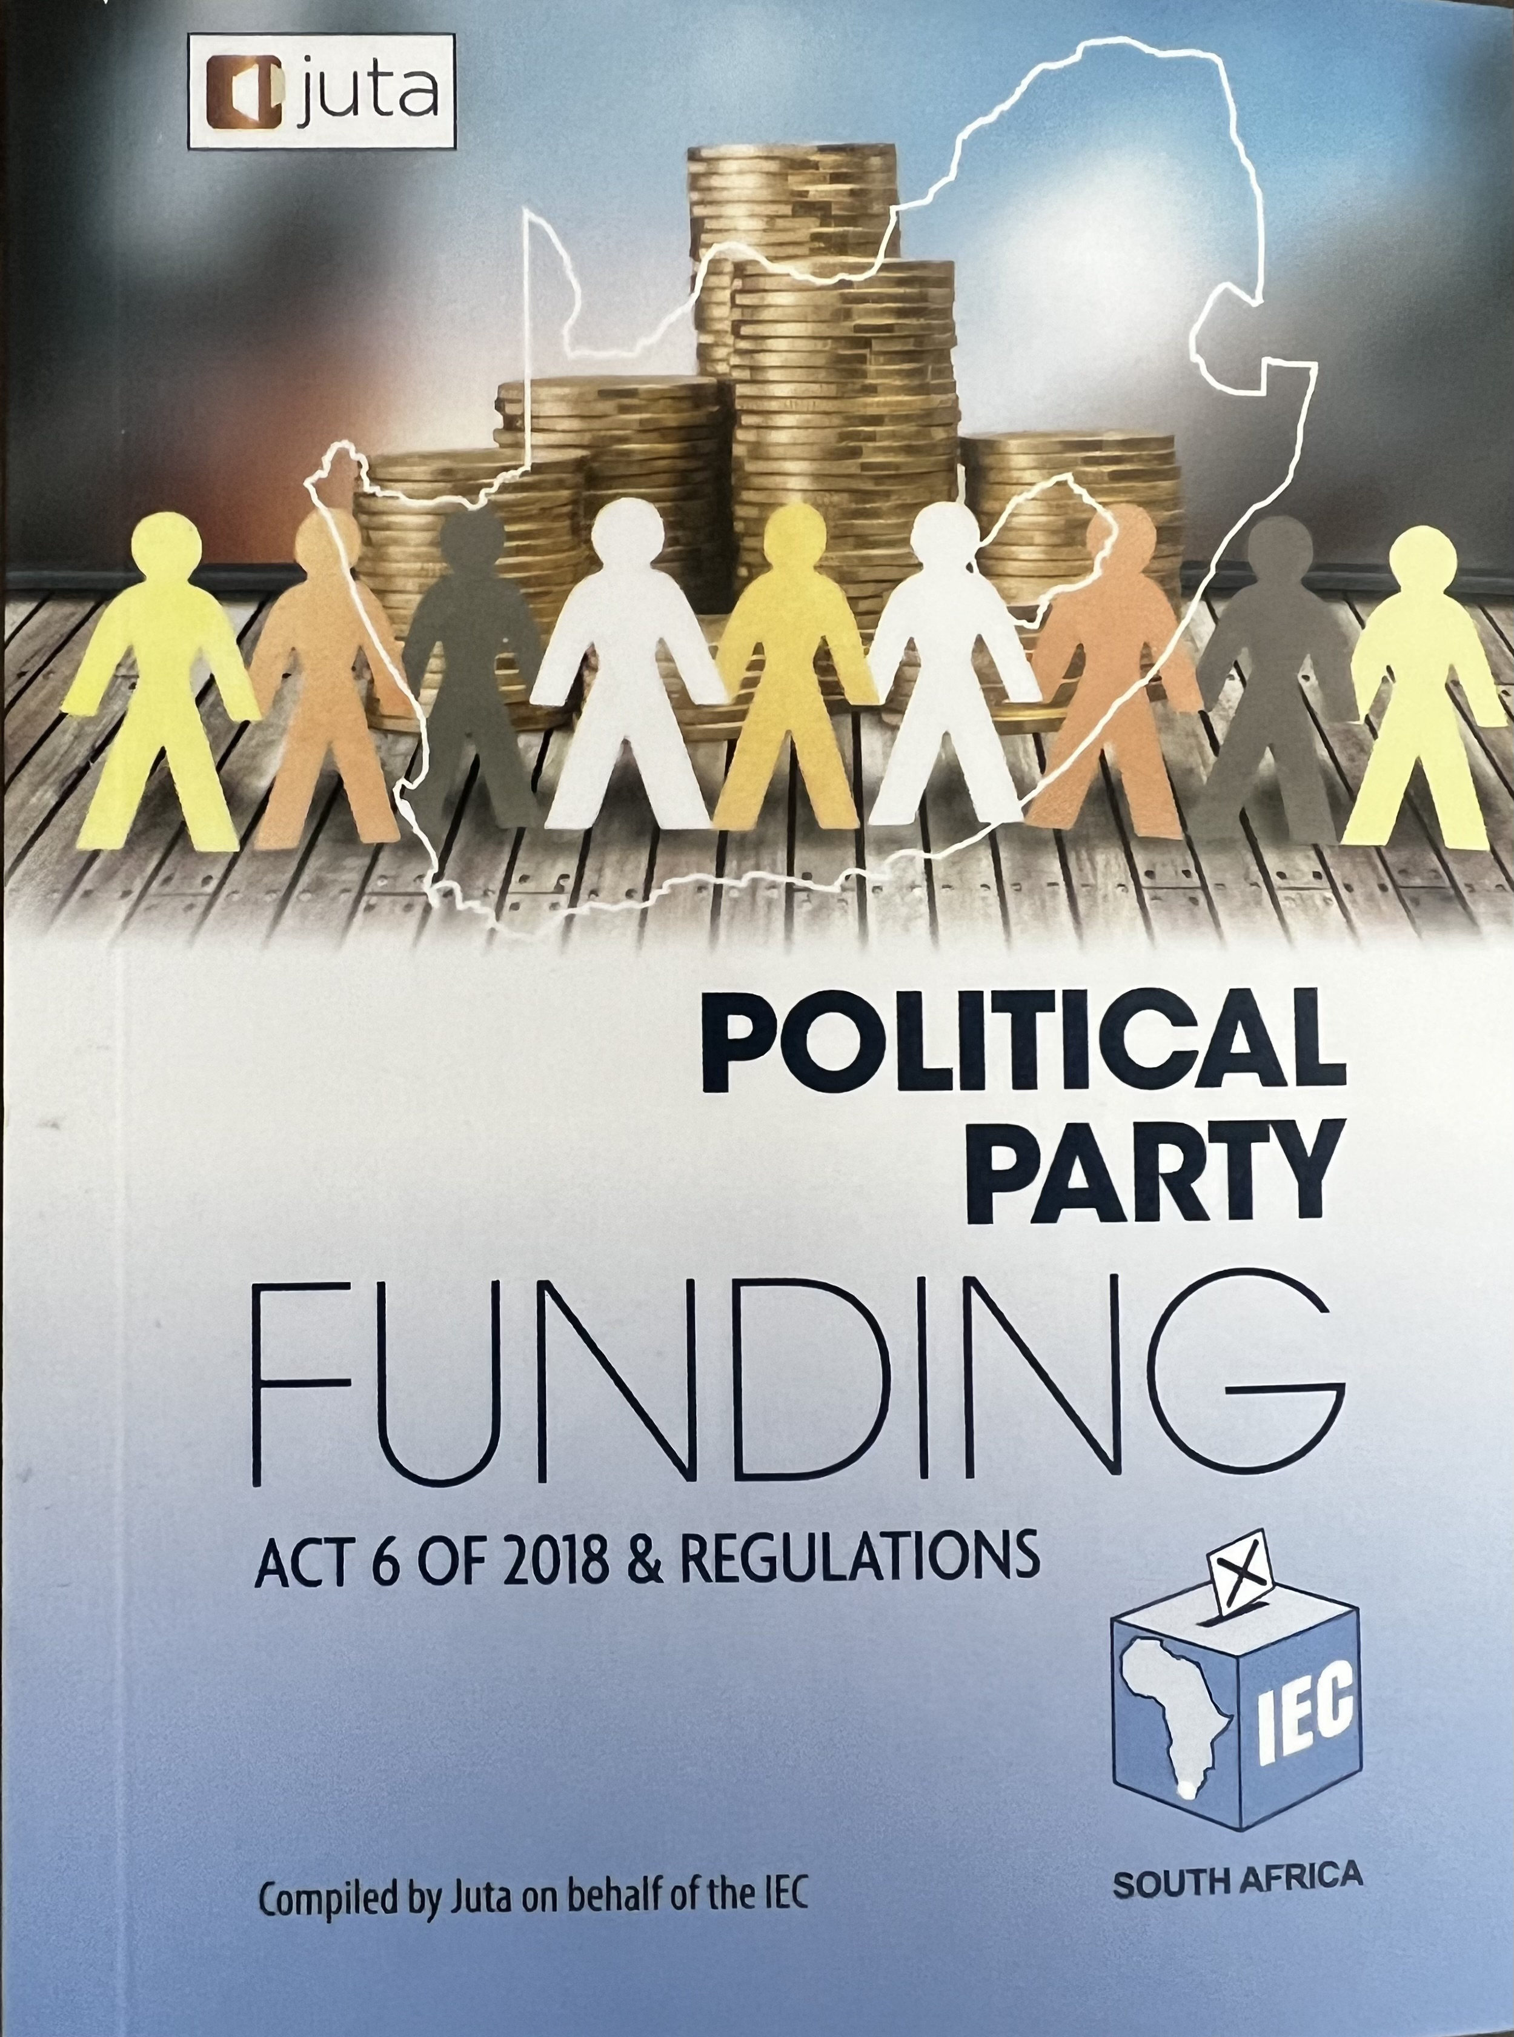

Slide 4
Political Party Funding
Purpose of the Act
The establishment and management of funds to fund represented political parties
To prohibit certain donations made directly to political parties
To regulate disclosure of donations accepted
To determine the duties of political parties in respect of funding
To provide for and regulate the public and private funding of political parties
To provide for administrative fines and create offences and penalties
To repeal the Public Funding of Represented Political Parties Act of 1997
To determine the duties of political parties in respect of funding
To provide for powers and duties of the Commission

Slide 5
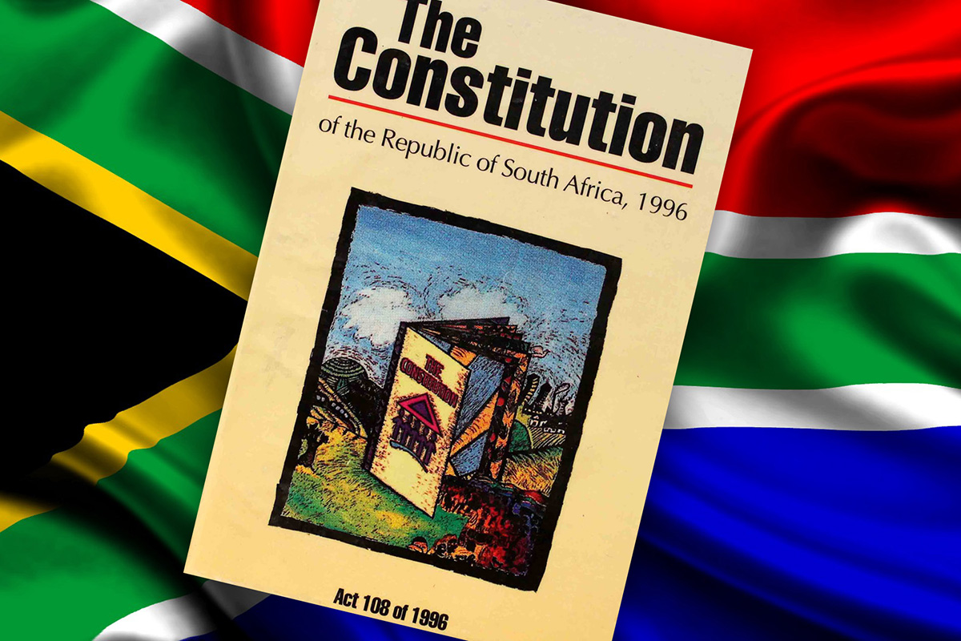
Political Party Funding
The Constitution establishes the foundational values of accountability and openness in a multi-party democracy;
It is important to deepen democracy, promote the national interest and to protect the sovereignty of the Republic;
The Republic’s International law obligations require it to incorporate the principle of transparency in the funding of political parties;
Section 236 of the Constitution, in promoting that principle, requires national legislation to provide for the funding of political parties participating in national and provincial legislatures on an equitable and proportional basis to enhance multi-party democracy
Effect is given to this section through money made available to those political parties from a fund created by law for that purpose
Section 44 of the Constitution affords Parliament legislative authority to pass legislation with regard to any matter, which would include to regulate private funding of political parties
Constitution, 1996:

Slide 6
Political Party Funding
Interpretation and Funds
Chapter 1 (Interpretation)
Consists of the definitions of the Act (sec.1)
Chapter 2 (Funds)
Establishment of the Represented Political Party Fund (sec.2)
Establishment of Multi-Party Democracy Fund (sec.3)
Investment of money in Funds (sec.4)
Management and administration of Funds (sec.5)
The allocation and payment of money to represented political parties(sec.6)
The purposes for which the money from the Funds may be used (sec.7)

Slide 7
Political Party Funding
Direct Funding and Duties of Political Parties
Chapter 3 (Direct funding of political parties)
Prohibited donations (sec.8)
Disclosure of donations to political parties (sec.9)
Prohibition of donations to a member of a political party(sec.10)
Chapter 4 (Duties of Political Parties)
Political parties to furnish information to the Commission at prescribed times(sec.11)
How political parties must account for its income (sec.12)
Unspent money at the end of a financial year (sec.13)

Slide 8
Political Party Funding
Enforcement
Chapter 5 (Enforcement)
Prohibited donations (sec.8)
Commission’s monitoring and inspection powers(sec.14)
Commission’s power to issue directions(sec.15)
Power to suspend payment of money to political parties (sec.16)
Power to recover money irregularly accepted or spent(sec.17)
Administrative fines (sec.18)
Offences and penalties (sec.19)
Reviews and appeals (sec.20)

Slide 9
Political Party Funding
General provisions
Chapter 6 (General Provisions)
Administration of the Funds within the Commission(sec.21)
Commission reporting to Parliament(sec.22)
Funding of represented political parties by legislatures(sec.23)
Regulations(sec.24)
Repeal and transitional provisions(sec.25)
Short title – Political Party Funding Act, 2018(sec.26)

Slide 10
Political Party Funding
Schedules 1 and 2
Schedule 1
Maximum permissible fines that the Commission may impose for contravening the Act.
Schedule 2
Regulations on Political Party Funding (Presidential regulations)

Slide 11
Political Party Funding
Commission’s Regulations
Regulations Regarding the Funding of Political Parties Issued in terms of Section 24(2) of the Political Party Funding Act, 2018.
Definitions (Reg. 1)
Request not to disclose contribution in terms of section 3(5) of the Act (Reg. 2)
Proceeds from Unlawful Activity (Reg. 3)
Determination of a fee to defray costs of administering and managing the Multi-Party Democracy Fund (Reg. 4)
Payment of money to represented political party (Reg.5)
Funding of Represented Political Parties by Legislatures (Reg. 6)
Disclosure of donations received by Political Parties in terms of Section 9 of the Act (Reg. 7)
Disclosure of donations made by juristic persons and entities (Reg. 8)
Publication of donations in terms of section 9(3) (Reg. 9)
Duties of accounting officer of political party (Reg. 10)
Issuing of direction by the Electoral Commission (Reg. 11)
Commencement date (Reg. 12)

Slide 12
Challenges Encountered

Slide 13
Political Party Funding
Challenges Encountered
Compliance-related challenges
Late submission of donation disclosures and declarations.
Non-submission of the required declaration forms by donors.
Donors making use of trading names rather than registered entity names.
Non-submission of supporting documents (proof of donations).
Internal Political Party Issues
Internal battles that result in the Commission being cited in legal issues.
Party in-fights that lead to failure to comply with the legislation and therefore suspension of funds.
Party creditors litigating against the Commission.
Unrepresented political parties
Absence of bank accounts.
Inability to comply with mandatory audit requirements.
Outdated or decommissioned contact details.
A vast majority of unrepresented parties do not submit audited financial statements.

Slide 14
Commission / Media Relationship How can the two work together to assist the SA public to better understand political party funding?

Slide 15
Commission / Media Relationship
It is important that there is a clear understanding of the role and responsibilities of the Commission in terms of the Act.
Collaborate in the management of misinformation or disinformaion.
Working together to develop and undertake a public awareness campaign ahead of the 2024 general election.
Proactively collate, contextualise and publish information about all sources of funding, including all relevant information about private sources. Investigative journalism is a very critical tool in this regard.
Embark on a comprehensive public awareness and education campaign about the PPFA with regards to:
The importance of political finance transparency for the integrity of their vote; and
To help voters ensure that political parties are accountable to voters rather than to special interests.
Help explain the IEC’s role and powers in ensuring compliance with the Act.

Slide 16
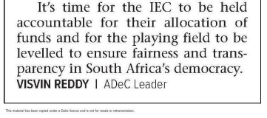
Commission / Media Relationship
The Mercury - p.2 - 7 Aug 2023
Allocated to: Economic Freedom Fighters (EFF), African National Congress (ANC) Unfair advantage in party funding
https://www.news24.com/news24/politics/government/iec-says-it-is-not-sure-whether-the-anc-declared-all-donations-20230517
What is the role of the Media companies in instances such as these?
Three parties - Cope, AI and the NFP - failed to submit their financial statement to the IEC, leading to the commission holding the parties' share of funding from Parliament and the multiparty democracy fund.

Slide 17
THANK YOU

