Slide 1
NPE 2024
What will be different?
08 August 2023

Slide 2
Contents
Background to introduction of Independent candidates
Key features
Nomination of Candidates
Threshold to contest
Deposits
Number of Ballots
Seat Allocation
Other Legislative Changes
Voters’ Roll Statistics

Slide 3
Background to Introduction of Independents

Slide 4
Background
In 2020 Constitutional Court declared aspects of the Electoral Act unconstitutional.
It ordered Parliament to remedy the defects within 24 months.
Judgement of the order predicated on rights of association, dignity and Section 19 Political Rights.
Court left choice of electoral system to Parliament. Similarly, did not pronounce preference of principles.
The requirement for an electoral system to result, in general, in proportional representation has not been changed.
Electoral Amendment Act became law in June 2023.

Slide 5
Key Features

Slide 6
National Assembly
The 400 seats in National Assembly which is the maximum set by RSA Constitution are retained.
Two tier Multimember compensatory Proportional system preserved:
200 seats are reserved for the National list (contested only by Parties )
Remaining 200 are divided up among the nine regions (contested by parties and Independents)
Regions share the same geographical boundaries as provinces.
Number of seats reserved for each region will be different, determined by the IEC before every NPE taking into account number of voters per region.

Slide 7
Provincial Legislatures
Single Tier Multi-member Proportional System.
Each Provincial Legislature election is a unique election.
Maximum of 80 and Minimum of 30 seats.
The Commission responsible for determining number of seats before every NPE.
In the case of the Western Cape, the number of seats (currently 42) is determined by the Provincial legislature ito the WC Provincial Constitution.
The Commission will determine the number of provincial seats for the other 8 provinces by December 2023.
Number of seats for each province will be different. Determined on the basis of the size of the population in each province. The Commission will use census data as the base scientific data on population.

Slide 8
National Council of Provinces (NCoP)
Members of the NCoP are not voted for by the voters
Each provincial legislature sends a delegation of 10 (ten) delegates respectively (4 special and 6 permanent) to represent their respective provinces in the NCoP.
Not to be confused with the regional seats in the National Assembly
8

Slide 9
Current seats in Legislatures and Split of Regional Seats (NPE2019).
Provincial Legislatures Regional Seats
WC 42 23
NW 33 13
NC 30 5
MPL 30 15
LP 49 19
KZN 80 41
GT 73 48
FS 30 11
EC 63 25
TOTAL 430 200
THE TOTAL NUMBER OF SEATS WILL BE UPDATED PRIOR TO NPE 2024

Slide 10
Nomination of candidates: Independents

Slide 11
Nomination of candidates: Independents
An independent person may be nominated to contest:
in one or more Regions but may only be elected to one seat of the National Assembly
a provincial legislature but only in the Province of registration.
An independent candidate may only be a member of either the National Assembly or a provincial legislature.
A prescribed nomination form must be submitted to the Commission by not later than the date stated in the Election Timetable.
11

Slide 12
Nomination of candidates: Independents
A prescribed declaration confirming that the candidate has submitted names, identity numbers and signatures of voters who support his or her candidature:
In relation to the election of the National Assembly, totalling 15 per cent of the regional seat quota for that region in the preceding election if contesting only in that region.
15 per cent of the highest of the regional seat quotas in the preceding election, if intending to contest more than one region.
Where the 15 per cent of the highest of the regional seat quotas is not achieved, that independent candidate may only contest the region or regions as determined by the next highest quota.
Voters can be on the registered anywhere in the country
In relation to a Provincial Legislature, 15 per cent of the provincial seat quota in the preceding election, in respect of that province and those voters must all be registered as voters in that particular province.
12

Slide 13
Nomination of candidates: Independents
Further Requirements:
Prescribed deposit (Proposed R15 000 for legislature and R20 000 for a regional seat in NA).
The amount to be deposited by an independent candidate contesting a provincial legislature must be less than the amount for contesting the National Assembly.
Deposits paid by independent candidates may be different to deposits paid by political parties.
Prescribed undertaking to be bound by the Code of Conduct
Prescribed declaration that the candidate is not disqualified in terms of the Constitution and applicable legislation
In respect of a provincial election, prescribed declaration that the independent candidate is a registered voter in that province
A recent photograph of the candidate in such form as may be prescribed
The Commission may request written Acceptance of Nomination
13

Slide 14
Nomination of candidates: Independents
Votes cast for an independent contesting on a number of regional ballots cannot be aggregated to obtain a seat, nor can independents aggregate their different votes to obtain a seat for one of them in a legislature.
Where an independent candidate qualifies for more than one seat in a region in the provisional allocation, such independent forfeits the additional seat/s.
Where an independent qualifies for more than one seat in more than one region – he/she shall retain the one won with the highest proportion of votes and forfeit the others.
14

Slide 15
Nomination of candidates: Political Parties

Slide 16
Registered parties
Registered at National Level or at provincial level for the provincial legislature wanting to contest
Only parties which are registered with the IEC at the time of close of nominations, can contest elections.
Parties registered at municipal level (Metro and District) not allowed to contest NPE
Organisations wishing to register a party or to upgrade their registration status must comply timeously with provisions of the Electoral Commission Act and Regulations
16

Slide 17
Nomination of candidates: All Parties
Prescribed deposit
Prescribed undertaking by authorised rep that party, its office- bearers, representatives and members are bound by the Code of Conduct
Prescribed undertaking, signed by each candidate that the candidate will be bound by Code of Conduct
Prescribed declaration that all the candidates are not disqualified in terms of the Constitution and applicable legislation and have signed the prescribed Acceptance of Nomination
Acceptance of Nomination for a candidate on request of the Commission
Additional Requirements:
A declaration that all party candidates for provincial legislatures are registered voters within those respective provinces
17

Slide 18
Nomination of candidates: All Parties
Lists cannot contain more names than seats in the legislature and must in in a fixed order of preference
Candidate can be nominate on a party’s regional list for one region and for the National List, but cannot be on more than one regional list for the same party
A party forfeits seats where there are insufficient names on that list
18

Slide 19
Nomination of candidates: Unrepresented parties in National Assembly
In the case of a party with no representation in the National Assembly, a prescribed declaration confirming that the party has submitted names, identity numbers and signatures of voters who support the party’s candidate nomination:
Totalling 15 per cent of the regional seat quota for that region in the preceding election if contesting only in that region.
15 per cent of the highest of the regional seat quotas in the preceding election, if intending to contest more than one region.
Where the 15 per cent of the highest of regional seat quotas is not achieved, that party may only contest the region or regions as determined by the next highest quota.
Voters can be on the registered anywhere in the country
19

Slide 20
Nomination of candidates: Unrepresented parties in provincial Legislatures
In the case of a party with no representation in the Provincial Legislature that it wants to contest, a prescribed declaration confirming that the party has submitted names, identity numbers and signatures of voters who support the party’s candidate nomination:
In relation to a Provincial Legislature, 15 per cent of the provincial seat quota in the preceding election, in respect of that province.
The voters must be registered in that province.
This is required for every province that the party want to contest.
20

Slide 21
PROPOSED DEPOSITS QUANTAMS
No | Election Type | Contestant | Current Deposit | Proposed Deposit
1 | Compensatory Election an Regional All Elections | Party | R200 000 | R300 000
2 | Compensatory Election At least one Regional Election | Party | R200 000 | R200 000 Plus R25 000 Per Regional Election
3 | Provincial Legislature | Party | R45 000 | R45 000 Per Legislature
4 | Regional Election National | Independent | None | R20 000 Per Regional Election
5 | National Assembly Provincial Legislature | Independent | None | R15 000 for a legislature in a Province in which a independent candidate is registered
21

Slide 22
Thresholds to Contest : Independents and unrepresented parties

Slide 23
9 Regional ballots for National Assembly & Quota for seats
19
75 529
48
92 601
15
79 499
13
71 016
11
75 602
41
86 967
5
68 474
25
77 713
23
88 008

Slide 24
Signature requirement: Regions*
Region | Seats | Quota NPE 2019 | Signature Quota 15%
Eastern Cape | 25 | 77 713 | 11 657
Free State | 11 | 75 602 | 11 340
Gauteng | 48 | 92 601 | 13 890
KwaZulu-Natal | 41 | 86 967 | 13 045
Limpopo | 19 | 75 529 | 11 329
Mpumalanga | 15 | 79 499 | 11 924
North West | 13 | 71 016 | 10 625
Northern Cape | 5 | 68 474 | 10 271
Western Cape | 23 | 88 008 | 13 201
Total | 200
24

Slide 25
9 Provincial Legislature ballots & Quota for seats
49
29 044
73
58 378
30
39 243
33
28 084
30
28 571
80
44 424
30
12 797
63
30 847
42
47 843

Slide 26
Signature requirement: Provinces*
Region | Seats | Seat Quota | Signature Quota
Eastern Cape | 63 | 30 847 | 4 627
Free State | 30 | 28 571 | 4 286
Gauteng | 73 | 58 378 | 8 757
KwaZulu-Natal | 80 | 44 424 | 6 664
Limpopo | 49 | 29 044 | 4 357
Mpumalanga | 30 | 39 243 | 5 886
North West | 33 | 28 084 | 4 213
Northern Cape | 30 | 12 797 | 1 920
Western Cape | 42 | 47 843 | 7 176
Total | 420
26

Slide 27
Three Ballots on Election Day

Slide 28
Types of Ballots
National Ballot on which only parties will appear – this is the same ballot for whole country
Regional Ballot – for the region in which the voting district of the voter is situated. Ballot will only have the parties and independents contesting in that region to represent that region in Parliament – each regional ballot will differ from region to region
Provincial Ballot – for the provincial legislature of the province in which the voting district of the voter is situated. Ballot will only have the parties and independents contesting in that province – each provincial ballot will differ from province to province
28

Slide 29
Three Ballots
Voters who vote at a voting station at which they are registered will receive three ballots on Election Day.
Voters voting in a voting station outside province of registration receive the national compensatory ballot only.
If the voter is outside his/her voting station:
May only vote provided they pre notified the IEC of their intention to vote and indicating a specific voting station at which they will vote. Section 24A now requires prior notification by the voter.
Special vote Application (sick/infirm) must apply to the IEC by date in the ETT and indicate where they will vote.
Overseas voting at designated embassies, missions will only receive one Ballot viz. the National Ballot (not regional ballot or provincial ballot)
29

Slide 30
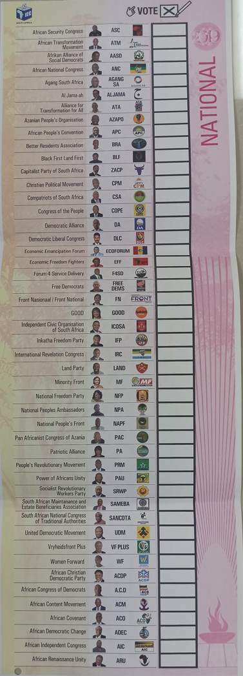
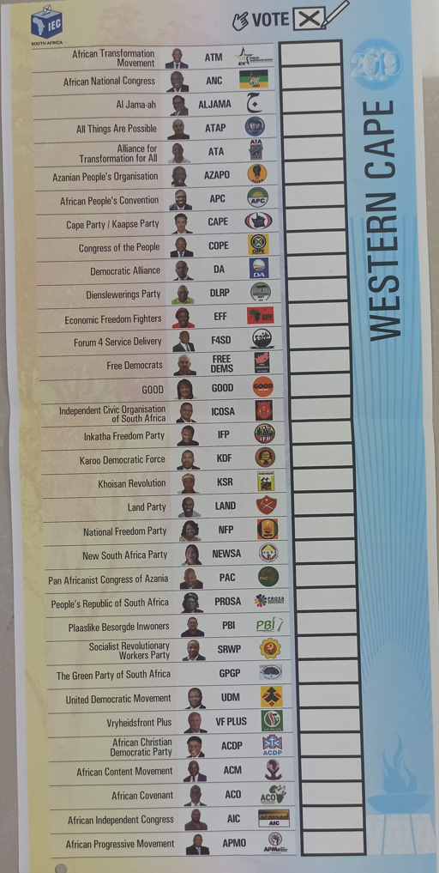
Ernest Jones
IND
Steven Gala
IND
Provincial
Regional
Ralph Mark
IND
Nozuko Dlamini
IND
Matthew Bing
IND
Nozuko Dlamini
Maria Gala
IND

Slide 31
Seat Allocation
Schedule 1A to the Electoral Act prescribes the method of allocating seats.
The method remains the same to the method used since 1994, with adaptation to facilitate Independent Participation.
First work out the quota for a seat by diving all valid votes by number of seats plus 1 then adding one to the result and disregarding fractions.
Total number of valid votes cast in favour of each party or independent is then divided by the quota.
Not all seats may be initially allocated. The highest remainder method is used to allocate seats not allocated by awarding seats according to the sequence of highest surplus votes (in National elections up to maximum of 5 seats thereafter default to highest average number of votes per seat).
31

Slide 32
Seat Allocation
If independent obtains votes that entitles it more than one seat, that candidates’ additional seat/s is forfeited.
32

Slide 33
Vacancies
Vacancies arise when a party candidate or independent dies, resigns or looses membership of the assembly.
Vacancy caused by the departure of a party candidate – the party nominates another candidate to fill the vacancy.
Vacancy caused by the departure of an Independent- A recalculation of the votes cast to determine which party or independent who contested the preceding election is entitled to be allocated the vacated seat:
- votes cast for the departing independent are disregarded
- votes and seats allocated to Independents already in office are also disregarded.
33

Slide 34
Vacancies
Simply put, the votes cast for the departing independent, nor the votes cast for, and the seats held by, independent candidates that already hold office in the legislature are also disregarded.
The result plus one, disregarding fractions, is the amended quota.
34

Slide 35
Other Changes
Section 24A application no longer available at the voting station on voting day (Pre-notification by date in Election Timetable indicating a specific voting station at which voter intends to vote.
Voters abroad do not need to inform the CEO of their intention to vote in the segment of registration.
Schedule 3 of Electoral Act allows Commission to determine the number of seats in a legislature.
35

Slide 36
Voters’ Roll Statistics: Total as at August 2023 25 996 509
14 381 447
Female
36
11 615 062
Male

Slide 37
Voters’ Roll Statistics: Age & Gender
Age | Female | Male | Total | Percentage of Grand Total
18-19 | 130 133 | 95 871 | 226 004 | 0.9%
20-29 | 2 041 912 | 1 689 965 | 3 731 877 | 14.4%
30-39 | 3 556 189 | 3 051 829 | 6 608 018 | 25.4%
40-49 | 3 051 181 | 2 759 057 | 5 810 238 | 22.4%
50-59 | 2 457 596 | 1 996 287 | 4 453 883 | 17.1%
60-69 | 1 739 223 | 1 265 592 | 3 004 815 | 11.6%
70-79 | 908 400 | 556 805 | 1 465 205 | 5.6%
80+ | 496 813 | 199 656 | 696 469 | 2.7%
Grand Total | 14 381 447 | 11 615 062 | 25 996 509 | 100.0%
Percentage | 55% | 45%
37

Slide 38
Voters’ Roll Statistics: Age & Gender
38

Slide 39
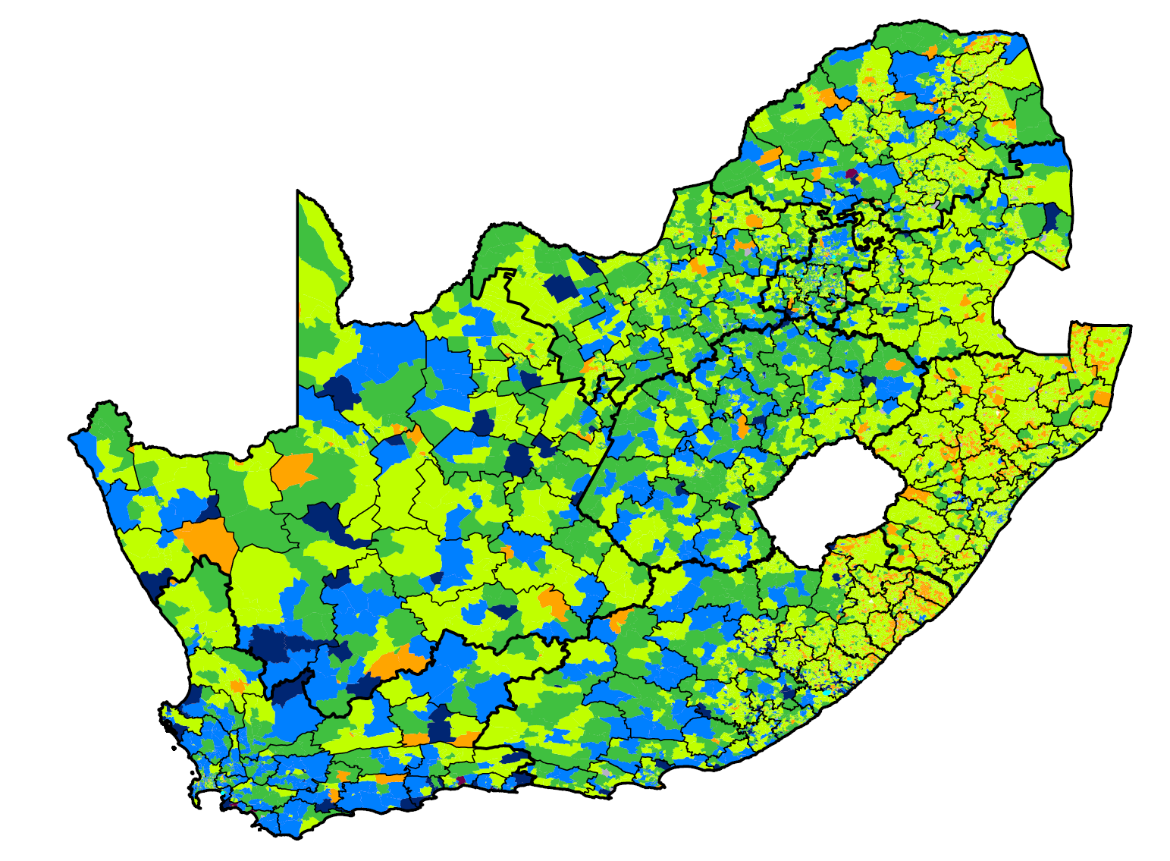
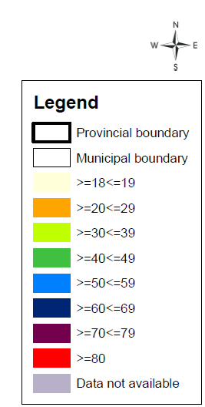
Voters’ Roll Statistics
Voter Registration by Predominant Age per VD, August 2023
39

Slide 40
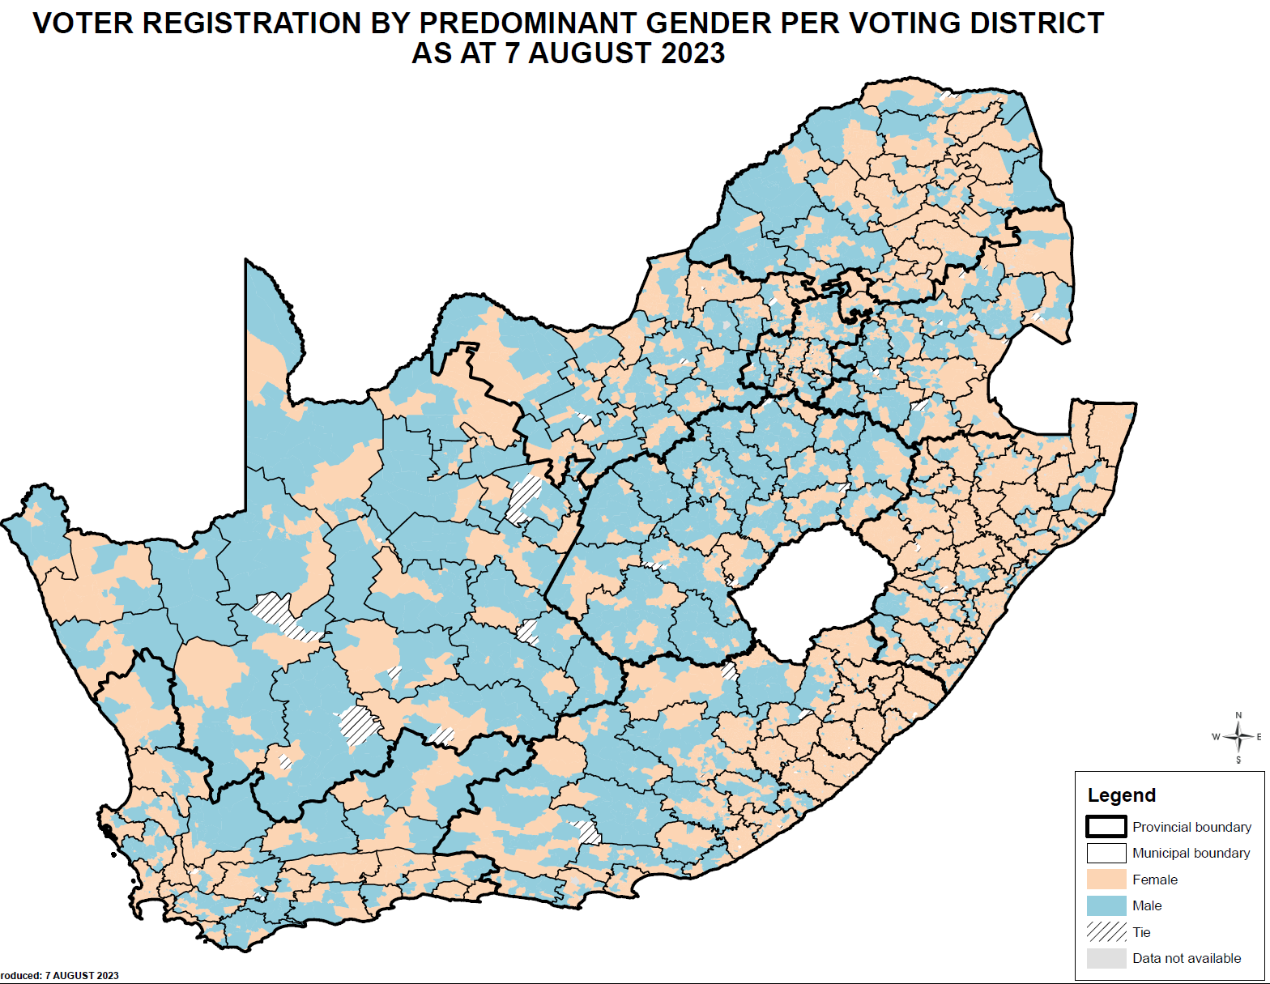
Voter Registration by Predominant Gender per VD, August 2023
40

