Slide 1
Elections 2024: Combating Disinformation, Strengthening Democracy
Media Monitoring Africa
Notes:
Tip: This template slidedeck is intended to help you shape the presentation by directing the topics that we need to be addressed in the slides. You are welcome to follow this format to the letter OR you can freely express your creativity and team culture through a changed layout and design if you wish. If you use the template, please feel free to add into the Appendix anything you feel was missed in the template that is important to communicate vis a vis your project. If you deviate from the template, please do check back at the end to ensure that every single topic eg. problem, solution, team etc. has been covered.
Tip: Remember to submit this deck as a PDF and no more than 10MB file size.
Tip: Say more with less. We assess at a lot of applications every year and the reality is that we can’t spend hours pouring over 50-page slide decks. It is possible to intrigue and inspire our project teams with very few slides, without overwhelming them with detail that might best be left for a potential interview.
Any important information that doesn’t make it into the main body of the presentation can either be included in the appendix or emailed to us at: meagnichallenge@google.com

Slide 2
Resources to make life better
IEC: - for latest news and information and links to essential content.
https://www.elections.org.za/pw/
SANEF elections portal being updated loads of cool stuff.
https://elections.sanef.org.za
Media Monitoring Africa - dashboard from dexter
https://www.mediamonitoringafrica.org/elections/
Real411- Online harms complaints portal
https://real411.org.za
PADRE- politicla ad repository & social media ad spend
https://padre.org.za
My Vote Counts - cool dashboard
https://myvotecounts.org.za/whose-vote-counts/
MARS - media attack reporting system - launch end August 2023

Slide 3
Enabling free and fair elections through supporting credible, independent media
Media Monitoring Africa (MMA) monitored South African media coverage of local government and national elections since 1994 our first democratic elections. Monitored to ascertain trends in coverage, determine issues media focused on, whether the coverage was biased, balanced and fair, diverse and, ethical.
MMA is unique both in our tools and methodology, and with all elections having been monitored MMA is also the only organization with the necessary track record to carry out such critical monitoring.
Notes:
Tip: Let us know what you want to do with a catchy title.
Tip: Give us some context about your organization with high level metrics or brand promise, etc.

Slide 4
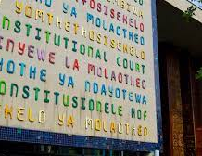
The Problem
Democracy is under threat. South Africa is dealing with unprecedented threats, and political analysts are calling the upcoming elections period as one of the most crucial, potentially violent elections periods in our young democracy
With the dramatic increase in mis and disinformation on social media platforms and the lack of strong digital and media literacy skills among the public, it becomes more important than ever before for traditional media to not only be credible but also well equipped to deliver their mandate of informing and educating.
As we move toward elections, mis and disinformation and other digital harms aren’t only likely, they are a certainty, and they pose clear threats to our democratic elections.
Notes:
Tip: Avoid too much detail here & keep your images light. You can provide as much info as relevant in the Appendix.

Slide 5
The Problem
There is a lack of strong digital and media literacy skills among the public;
As much as the media have a critical role to play, the public too also need to ensure that they are equipped with the tools and skills to spot mis and disinformation and to act on it when they do come across it.
Our current political climate, and recent changes to the Electoral Act, pose a different set of challenges for the media and how they will ensure equitable, fair, and accurate coverage.
Notes:
Tip: Avoid too much detail here & keep your images light. You can provide as much info as relevant in the Appendix.

Slide 6
Our solution
A multistakeholder partnership with the Independent Electoral Commission (IEC), and a framework of cooperation between the IEC, social media platforms, and MMA, using dedicated tools, we will help combat and mitigate disinformation and other online harms during the election period.
"Knowledge is power. Information is liberating. Education is the premise of progress, in every society, in every family. (…) Because an educated electorate is a powerful electorate. Because an informed citizenry is the greatest defender of freedom” – Kofi Annan, former UN Secretary General.
Increased transparency and accountability around social media political ad spend in the lead up to the South African national and provincial elections.
Monitoring, analysing and producing live data results on media’s coverage of the lead up to 2024 national elections, as well as voting day and post elections period.
In partnership with the IEC, and other key stakeholders, implement a strategic digital campaign focusing on democracy awareness and literacy.
Notes:
Tip: Avoid industry jargon here.
Tip: Explain it to us like we were a friend in a different industry who has sat down for a coffee with you.

Slide 7
Combating Disinformation, Strengthening Democracy
Combating election related disinformation
Promoting transparency and accountability
Quality, fair, equitable media coverage
Democracy awareness and literacy campaign
Public facing dashboard with live election coverage results
Strategic social media campaign (in partnership with the IEC)
Real411 complaints platform in partnership with the IEC
Ad Observatory
Training political parties on social media usage during elections
Political Ad Repository (PAdRE)
Elections journalism fellowship
Framework of cooperation
Training workshops with IEC and journalists on political ad spend on social media
Produce monthly elections coverage analysis
Notes:
Tip: There is no need to share concrete revenue numbers or audience figures. Percentage increase/ decreases are very adequate.

Slide 8
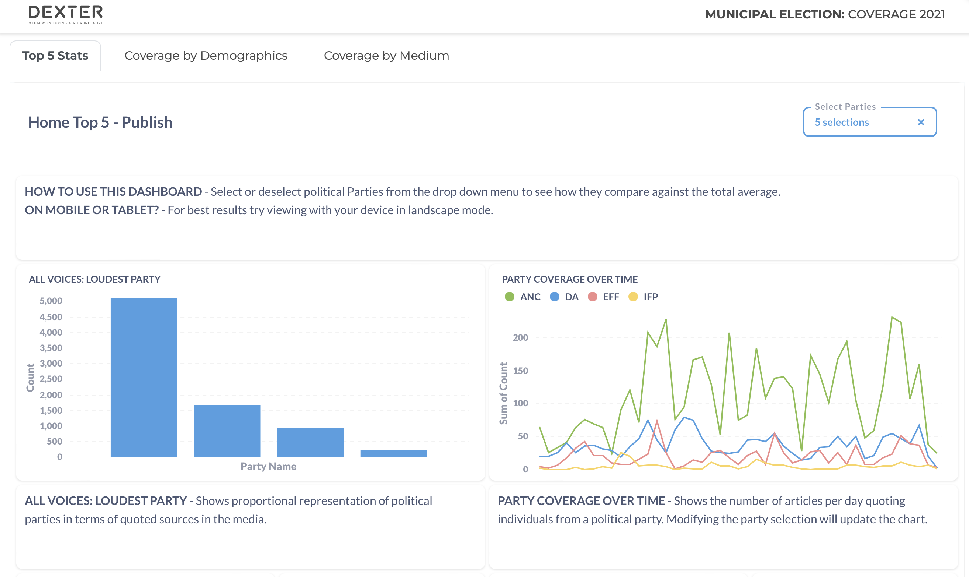
DEXTER explained
Dexter MMA’s media monitoring civic tech tool. Over 2 million curated news stories.
Machine learning and NLP to extract sources, utterances and more!
Data used to generate dashboard for elections.
Notes:
Tip: Also include your unique selling proposition (USP) and/ or your project’s competitive advantage.

Slide 9
About Real411
One of the most innovative approaches was first trialed in 2019. Real411 was run with the IEC in the lead up to South Africa national elections in 2019. Real411 sought to ensure that:
Key stakeholders were playing by the same rules. (Up to that point social media were generally playing by rules set beyond our borders);
There was a mechanism for the public to act against disinformation, thus empowering the public and citizens to act against disinformation thus helping to mitigate its impact;
Real411 offers one central place for the public to report regardless of the platform, and
The IEC was able to deal with complaints across digital platforms.
The proposed project will build on existing relationships with the IEC and improve systems and process to successfully implement the solution to combat election related disinformation in our 2024 national elections.
Notes:
Tip: Avoid industry jargon here.
Tip: Explain it to us like we were a friend in a different industry who has sat down for a coffee with you.

Slide 10
About Real411
www.real411.org.za
Public complaints platform to combat online harms including:
Mis and disinformation
Incitement to violence
Hate speech
Harassment
Locally developed, speedy, independent, transparent, rights-based solution

Slide 11
PAdRe Explained
The Political Party Advert Repository (Padre) is a South African first and aims to ensure and increase access to information in elections in South Africa, in line with the African Commission on Human and Peoples' Rights' Guidelines On Access To Information And Elections In Africa.
Padre is an initiative of the Electoral Commission of South Africa (IEC) supported by Media Monitoring Africa (MMA), aimed at supporting free and fair elections by ensuring access to information during the elections period.
Notes:
Tip: Also include your unique selling proposition (USP) and/ or your project’s competitive advantage.

Slide 12
PAdRe Explained
To access the site
URL: www.padre.org.za
To register please send information to
Email padre@mma.org.
For more information / comments / concerns
Contact: info@padre.org.za / info@mma.org.za

